Slide 1
Exploring Pressure Sensors
Reggie Garza : Team 3

Slide 2
Agenda
Introduction to Pressure Sensors
Types of Pressure Sensors
What are The Different Types of Pressure That Can Be Measured
How do They Work
Works Cited

Slide 3
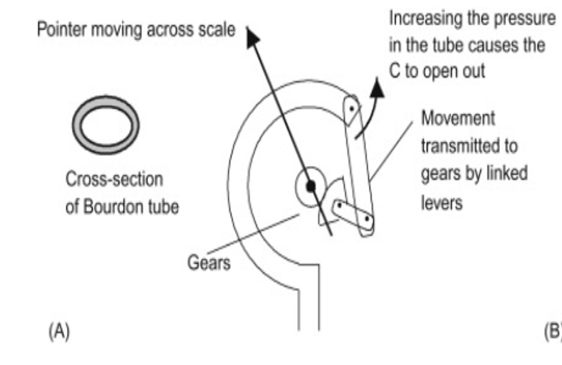
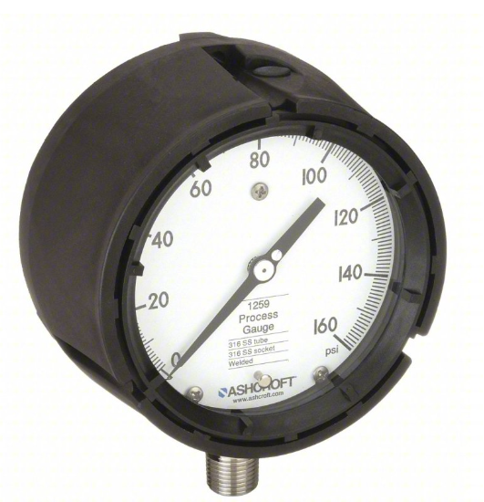
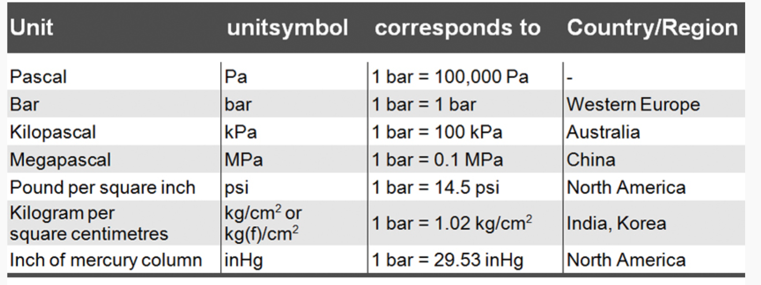
Introduction to Pressure Sensors
The first pressure sensing device was invented by the French industrialist Eugene Bourdon in 1849. It is known as the Bourdon Tube and is still used today due to its simplicity.

Slide 4
Types of Pressure Sensors
Piezoresistive strain gauge sensors
Earliest and most widely used. Their simple construction means low cost ant durability. The resistive elements are bonded to the diaphragm.
Capacitive
Utilize a capacitive element that is mechanically simple and robust. More expensive but can operate at a wider temperature range.
Piezoelectric
Very robust and low power. Can tolerate very high temperatures (1,000 °C).Main draw back is that they require a charge amplifier to convert high impedance charge output to a voltage signal and they can be only used for dynamic pressure measurement.

Slide 5
What are The Different Types of Pressure That Can Be Measured?
Absolute Pressure
Gauge Pressure
Differential Pressure

Slide 6
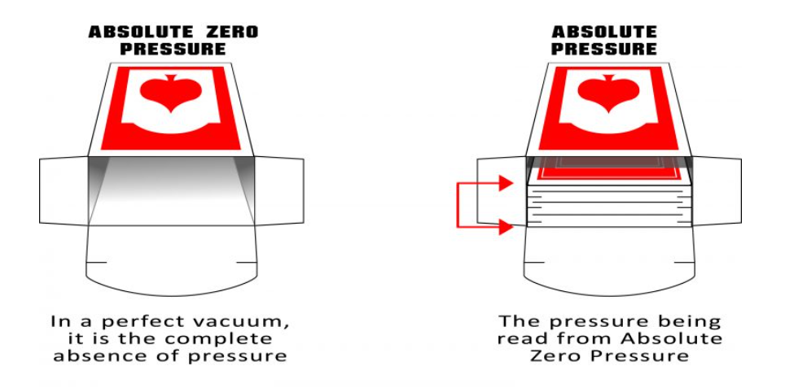
Absolute Pressure
What is absolute pressure?
Is the pressure being measured in relation to absolute zero pressure (the point of zero pressure in a perfect vacuum, 0 PSIa).
Measurement can only be positive.

Slide 7
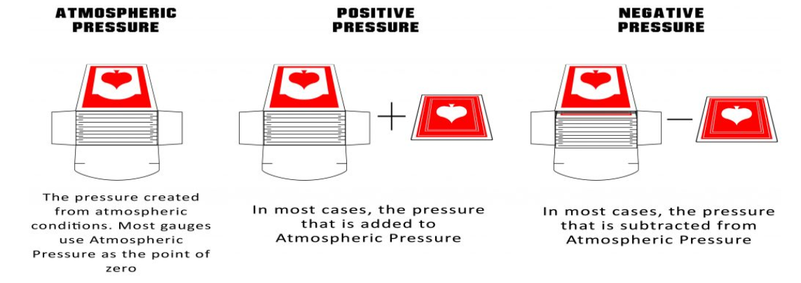
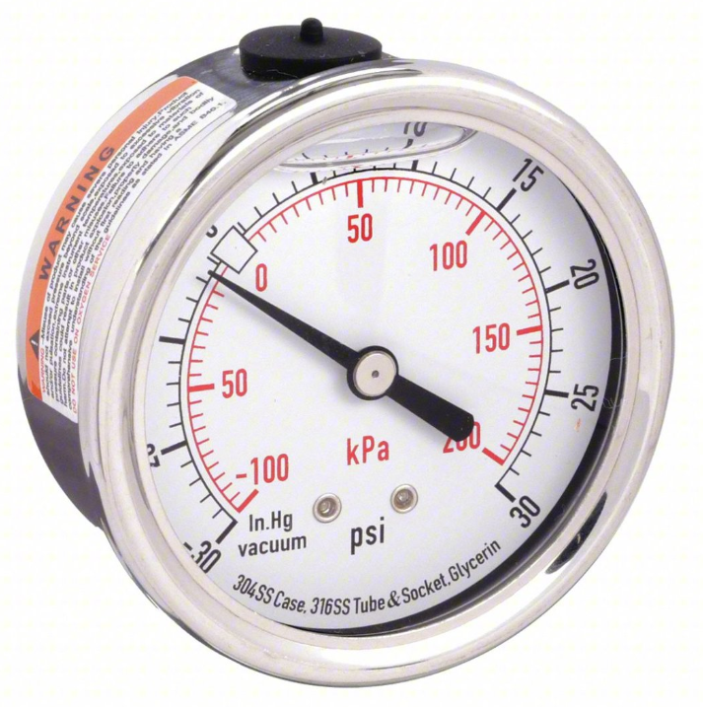
Gauge Pressure
What is gauge pressure?
Is the pressure being measured in relation to the atmospheric pressure of the earth (typically 0 PSIg or 14.7 PSIa).
Measurement can be negative or positive.

Slide 8
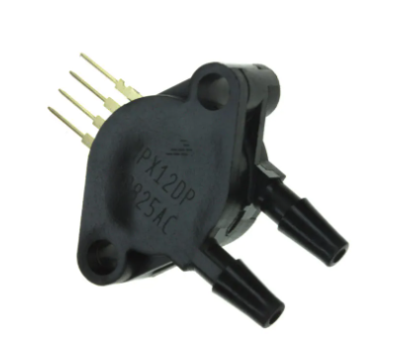
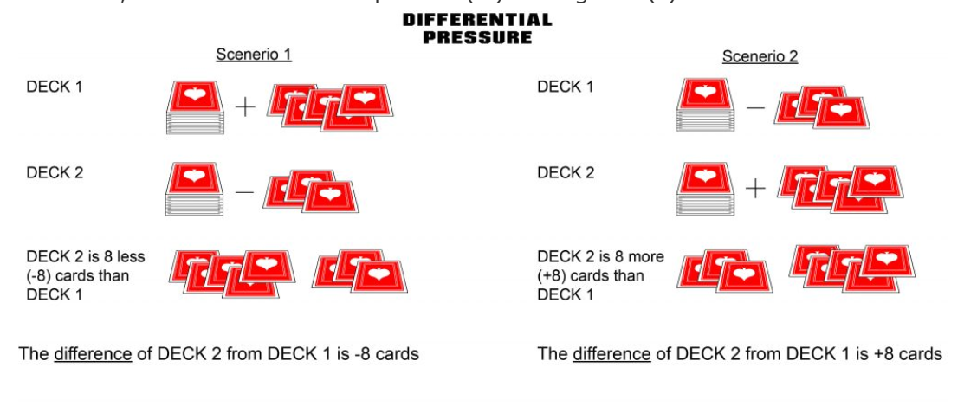
Differential Pressure
What is differential pressure?
Is the pressure difference between two points. It can even be the difference between atmospheric pressure and a second pressure or the difference between a vacuum and the second pressure.
Measurement can be negative or positive.

Slide 9
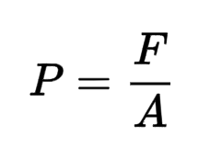
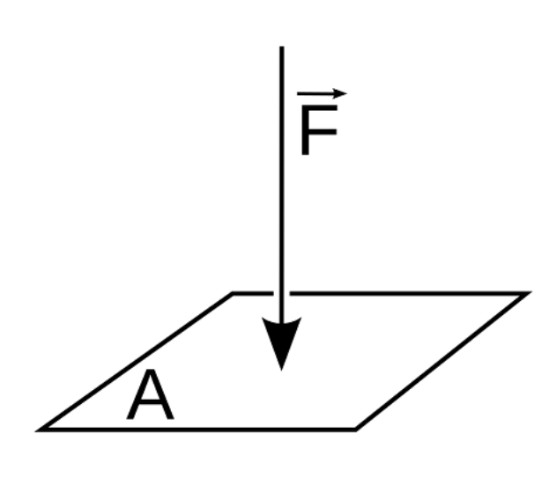
How Do They Work
Differential pressure sensors work by measuring the deflection of a diaphragm caused by the pressure being measured. The deflection is then converted into an electrical signal that can be read by a computer or other device.
The signal output by the sensor can be either digital or analog. It’s dependent on the manufacturer.

Slide 10
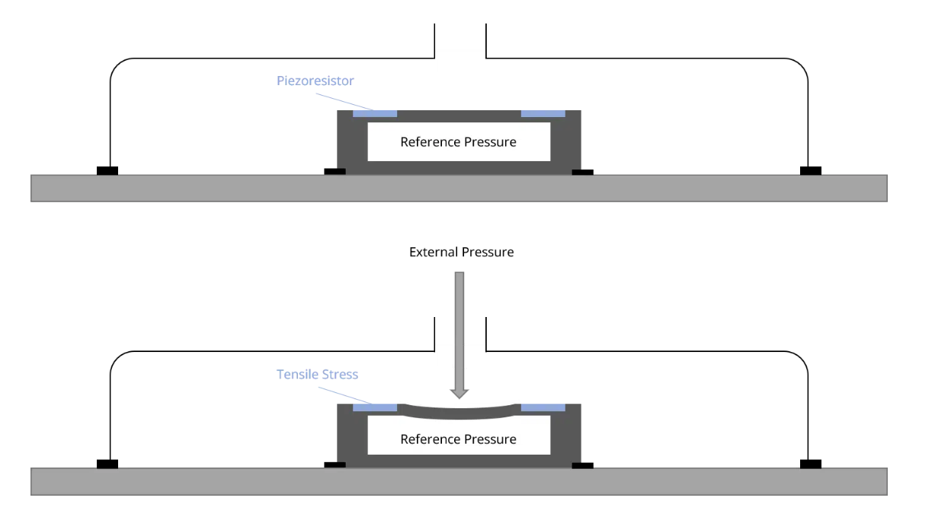
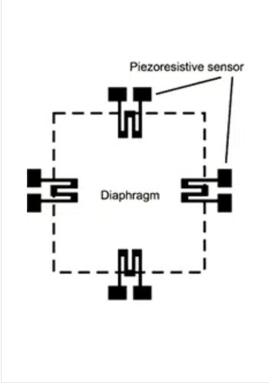
How is the electrical signal generated?
Piezoresistive Sensor
Four resistors are placed on a silicon diaphragm in order to measure the result of strain or physical pressure applied upon them. Any perceptible change in resistance is being converted, through a Wheatstone bridge circuit into an output voltage.

Slide 11
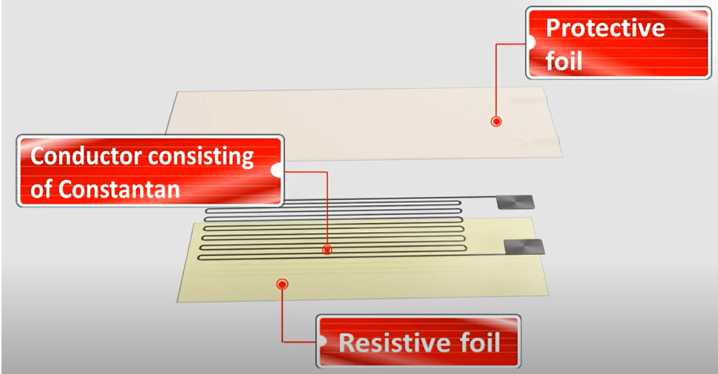
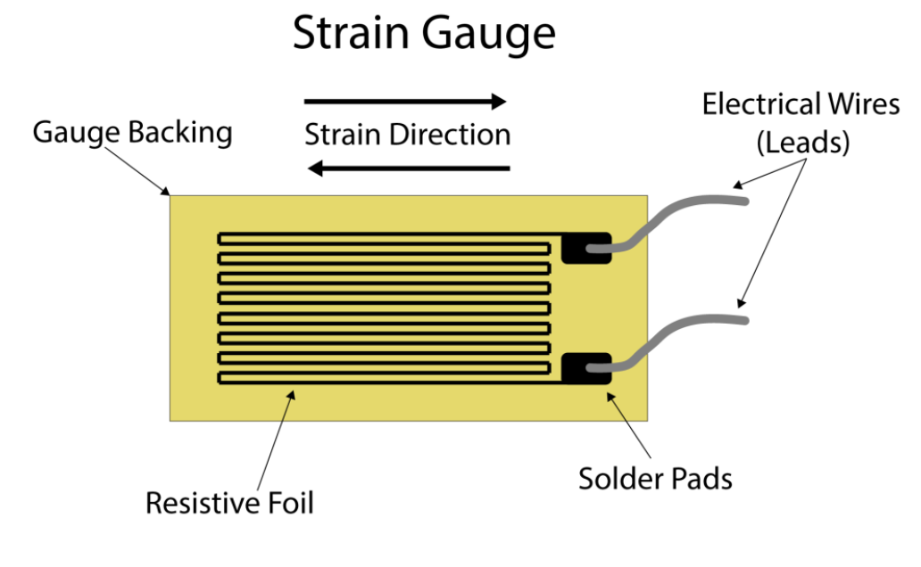
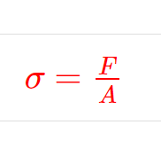
How does it convert pressure into electrical output?
Strain Gauge
It is a sensor whose measured electrical resistance varies with changes in strain. Strain is the deformation or displacement of material that results from an applied stress.

Slide 12
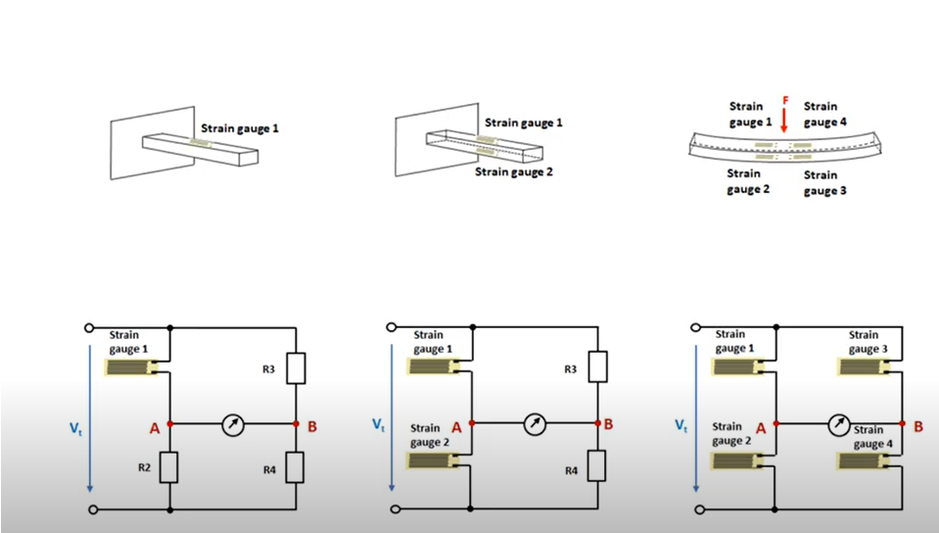
Merging the strain gauge with Wheatstone bridge
Sensitivity
Different configurations for the gauge/bridge configuration.
One strain gauge → Quarter bridge configuration.
Two strain gauge → Half bridge configuration.
Four strain gauge → Full bridge configuration

Slide 13
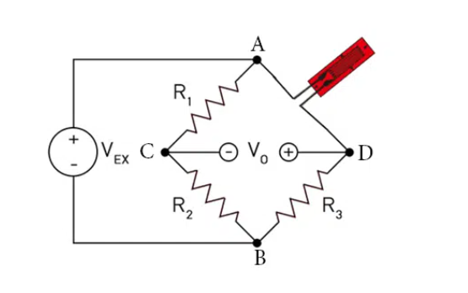

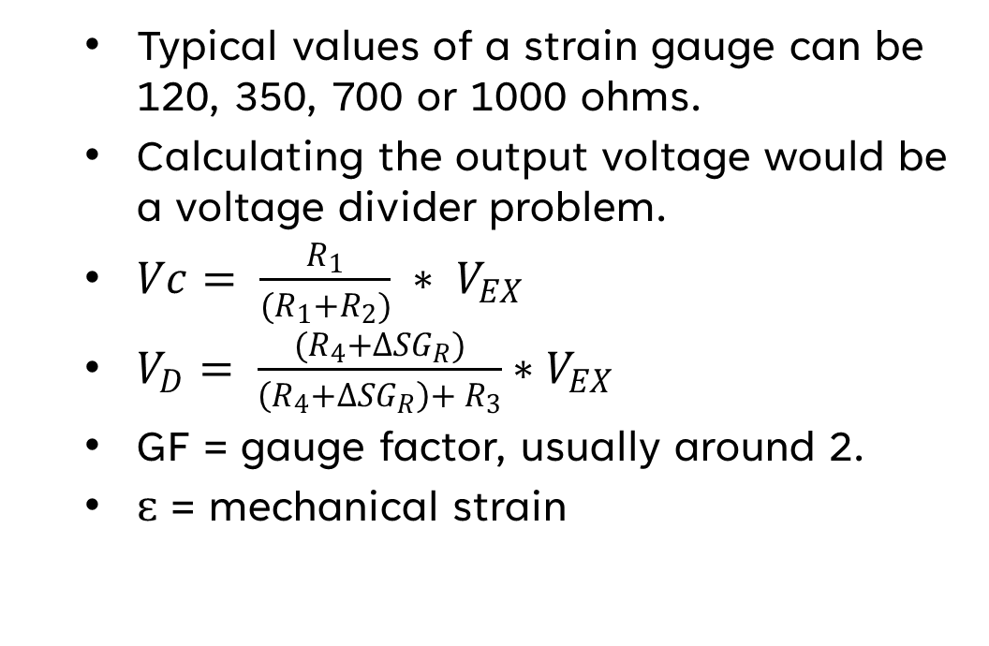
Calculating the Vout of a Quarter bridge configuration.
Typical values of a strain gauge can be 120, 350, 700 or 1000 ohms.
Calculating the output voltage would be a voltage divider problem.
$Vc= \frac{R_{1}}{(R_{1}+R_{2})} ∗ V_{EX}$
$V_{D}= \frac{(R_{4}+∆{SG}_{R})}{\left(R_{4}+∆{SG}_{R}\right)+ R_{3}}∗V_{EX}$
GF = gauge factor, usually around 2.
ԑ = mechanical strain

Slide 14
Sources cited
https://www.sensorland.com/HowPage059.html
https://www.sciencedirect.com/topics/engineering/bourdon-tube
https://www.variohm.com/news-media/technical-blog-archive/working-principle-of-a-pressure-sensor
https://www.sensocon.com/news
https://www.setra.com/blog/what-is-absolute-pressure
https://www.michsci.com/what-is-a-strain-gauge
https://collegedunia.com/exams/stress-formula-physics-articleid-1460
https://www.bestech.com.au/blogs/understanding-a-wheatstone-bridge-strain-gauge-circuit

Slide 15
Thank you!

